Slide 1
Web Crawler, Indexer, and Search
A programming and implementation project by
Chris Wieringa
Prof. Murali Mani
CSC530, UM Flint, Fall 2020
Notes:
Welcome everyone! My name is Chris Wieringa, and today I’m going to talk to you about a programming and implementation project called “Web Crawler, Indexer, and Search”.

Slide 2
Outline
Introduction
Web Crawler
Indexer
Search
Project Results
Future Work
References
Notes:
So here’s the brief outline of what I want to talk about today. I’ll start with a brief introduction to the project, especially why I was interested in doing a project like this. I’ll move onto the web crawler program that I put together using Python. Next I’ll talk about the Index software, Apache Solr, that was used to create a searchable index for the project. I’ll follow that with my work on programming a user-friendly search web site, like what you would expect with a modern search engine today. Then I’ll cover my project results, and I’ll finish by briefly touching on possible future work with the project, and some references for the project.

Slide 3
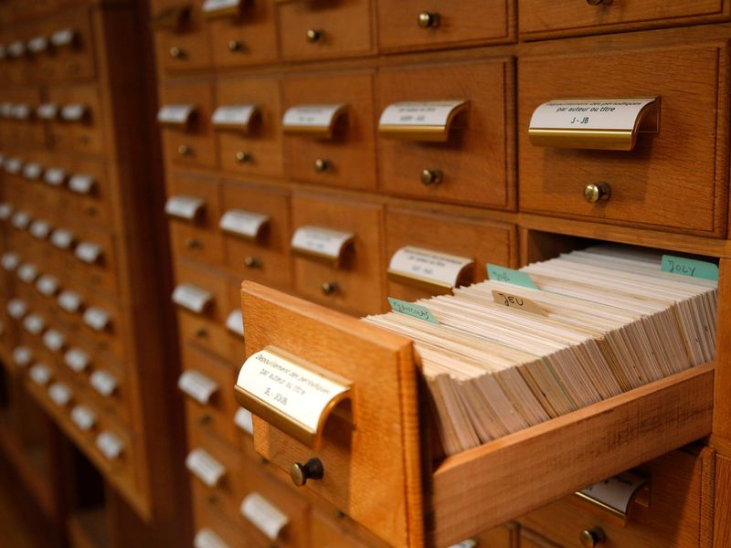
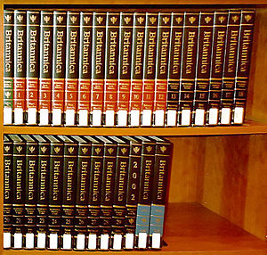
Introduction
How many people remember when they were introduced to the wonder of web search?
How many people remember or know what we did for search before web search?
Source: https://www.smithsonianmag.com/smart-news/card-catalog-dead-180956823/
Source: https://en.wikipedia.org/wiki/Encyclopedia
Notes:
I want to start off today with a question. How many people here remember when they were introduced to the wonder of web search? I don’t know who all is in the audience today, but I’m guessing that there are people here that remember distinctly when the “magic” of the internet and web search started to impact their lives. I’m also guessing that there are people here that web search has existed all their life; they can’t remember a time without it, and they might not think that it is super important afterall. I fall into the first group that I discussed here; I remember distinctly when web search came into my life. Now for the second question – how many people remember (or know) what we did for search before web search? Card catalogs at the library, or having our own copy of an Encyclopedia?

Slide 4
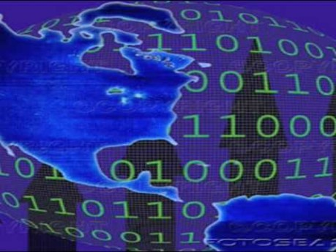
Introduction
Source: https://www.youtube.com/watch?v=gsNaR6FRuO0
Notes:
Let me take you back a bit with some nostalgia; take a listen to this audio in this Youtube clip. How many of you here have heard this before in-person? I’m a little bit older, but I remember fondly the harsh tones of a modem connecting over a phone line to another computer, whether it was to a local bulletin board system (BBS), America Online, or another dialup internet service provider. I I lived through the transition from a computer that just operated standalone to when computers connected to internet and had troves of information available to them. Go back with me 30 years.

Slide 5


Introduction
My Personal History:
1991-1995: BBS systems and first email address
1991-1993: Gopher document system; first electronic search for documents through Veronica1
1994-1995: Introduction to the World Wide Web2
Netscape Navigator – web browser3
Yahoo – web directory
- first “word” search in any webpage5
Notes:
I want to bring you back to the early 90s because I remember the “woah” and “ah-hah” moment in my life when I was first introduced to the amazing technology of the world wide web, and specifically, a web search engine. Let’s cover a bit of history, how I remember it especially. I remember having a 486 computer running Windows 3.1 when my parents first brought home a 14.4kbps dialup modem around 1991. I remember dialing into local BBS, or bulletin board systems, in my hometown. This offered for the first time the amazing access to play asynchronous online games with other people, to access and share documents electronically, and to also have my first ever email account. I can also remember when Gopher started to be popular. For a first time, there were linked computer systems with organized information documents available, and amazingly a simple search tool that would help locate the documents called Veronica. While Gopher was definitely cool, it was abruptly replaced completely by the introduction of the World Wide Web. I remember loading the Netscape Navigator web browser, and when I was introduced to the fledging World Wide Web. In those days, sites like Yahoo existed but operated as directories sorted by topics. I remember finally being introduced to Webcrawler and finally having this “woah” moment; here was a site that I didn’t have to browse a topics list but could finally provide just a word to search for and it would give me matching sites back in return. This was so cool; and this really was the “ah-hah” moment of how cool and life-changing this technology really is.

Slide 6
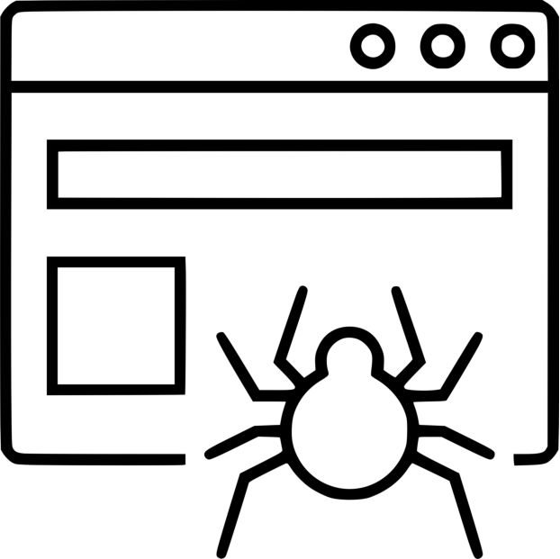


Introduction
What I wanted to do with this project:
MySQL DB / Filesystem
5
Web Crawler
(Program my own!)
7
Search Interface (Program my own!)
6
Text Indexer (Use Apache Solr!)
Notes:
Since then, I have always wondered how this incredible search technology works. This really lays the groundwork for why I thought that this project would be interesting.
The first piece that has always interested me is the web crawler – how does it work? For this project, I wanted to program my own. There are open-source crawlers available, such as Apache Nutch, but I wanted to figure out how to make one myself.
The second piece of this is the indexer. I decided that it would be best to implement an indexer already out there, specifically Apache Solr.
And last, I wanted to provide a search interface. I decided I wanted to program one of these as well.
These pieces all tie together – the web crawler feeds information to Solr, and the Search interface interacts with Solr as well. I additionally needed a database to keep track of the state of my crawler and what pages had been sent to the indexer.

Slide 7
Outline
Introduction
Web Crawler
Indexer
Search
Project Results
Future Work
References

Slide 8
Web Crawler
How does a web crawler work?
Download a webpage.
Recursively process and download every single link in the page.
Linked Page
Linked Page
Start Page
Linked Page
Linked Page
Linked Page
Exponential growth in the total number of pages!
Linked Page
Linked Page
Linked Page
Linked Page
Linked Page
Linked Page
Notes:
So how does a web crawler work? Well, it has a basic premise. I want to start with a web page, or my start page. I’m going to download that webpage. Then I’m going to parse the page for all the links to other web pages. For each one of these links, I’m going to recursively process the link and continue to crawl outwards starting the process all over again.
There definitely is an exponential growth in the total number of pages over time!

Slide 9
Web Crawler
Python scripts and MySQL database
Make “ranks” for my webpages; starting pages are rank 1, all linked pages are rank 2. Continue down ranks…
Download the web page to the file system using ‘wget’
Parse all links using BeautifulSoup 8
Manage URL state in MySQL database using dataset 9
Robots.txt support through urllib.robotparser 10
Challenges:
Content-Type detection – only deal with HTML pages and not images, CSS, xml, etc…
No duplicate URLs
Single-threaded performance
Bandwidth and Hard drive space!
Notes:
So for my web crawler, I decided I wanted to get down and dirty and build my own from scratch. I decided that I would use Python code along with a MySQL database backend to keep track of the state of the URLs. For my design, I decided to keep track of the depth that I encountered each URL at, which I called the “rank”. My starting pages would be rank 1 pages; any page they linked to would become rank 2 pages. Each rank 2 page would be processed and sites they linked to would be rank 3 pages, etc. As the basic operations, I downloaded each web page using the wget program - which is a command line program to download a URL. After downloading the page, I’d parse all the links using the Python module BeautifulSoup. I’d also keep track of my sites that I had seen, crawled, downloaded, etc in a MySQL database using the Python module dataset. To be a good netizen, I implemented basic robots.txt support through urllib.robotparser, which would let me check if I had permission to download a webpage before I just went to get it.
Some of the challenges that I had in putting this together included having to figure out what type of content I had. You can’t always trust a URL to tell you exactly what it is; for example some image files may not have a common image extension. I only wanted to deal with HTML pages, so I had to do some detection when I started the download to see if I wanted to actually fully download a particular URL; skipping any document type besides HTML documents. I also had to keep track of duplicate URLs; quite frequently multiple sites linked to the same pages. Single-threaded performance was very limiting – only being able download a single page at a time is slow. I ended up implementing a threaded crawler that would do 16 sites simultaneously, which pretty much swamped my crawling computer. And lastly, bandwidth – both total bandwidth and data caps - along with plain hard drive space to save these HTML files were also challenges. I ended up running this (with permission) at the academic institution where I work, which dealt with the bandwidth issues at least.

Slide 10
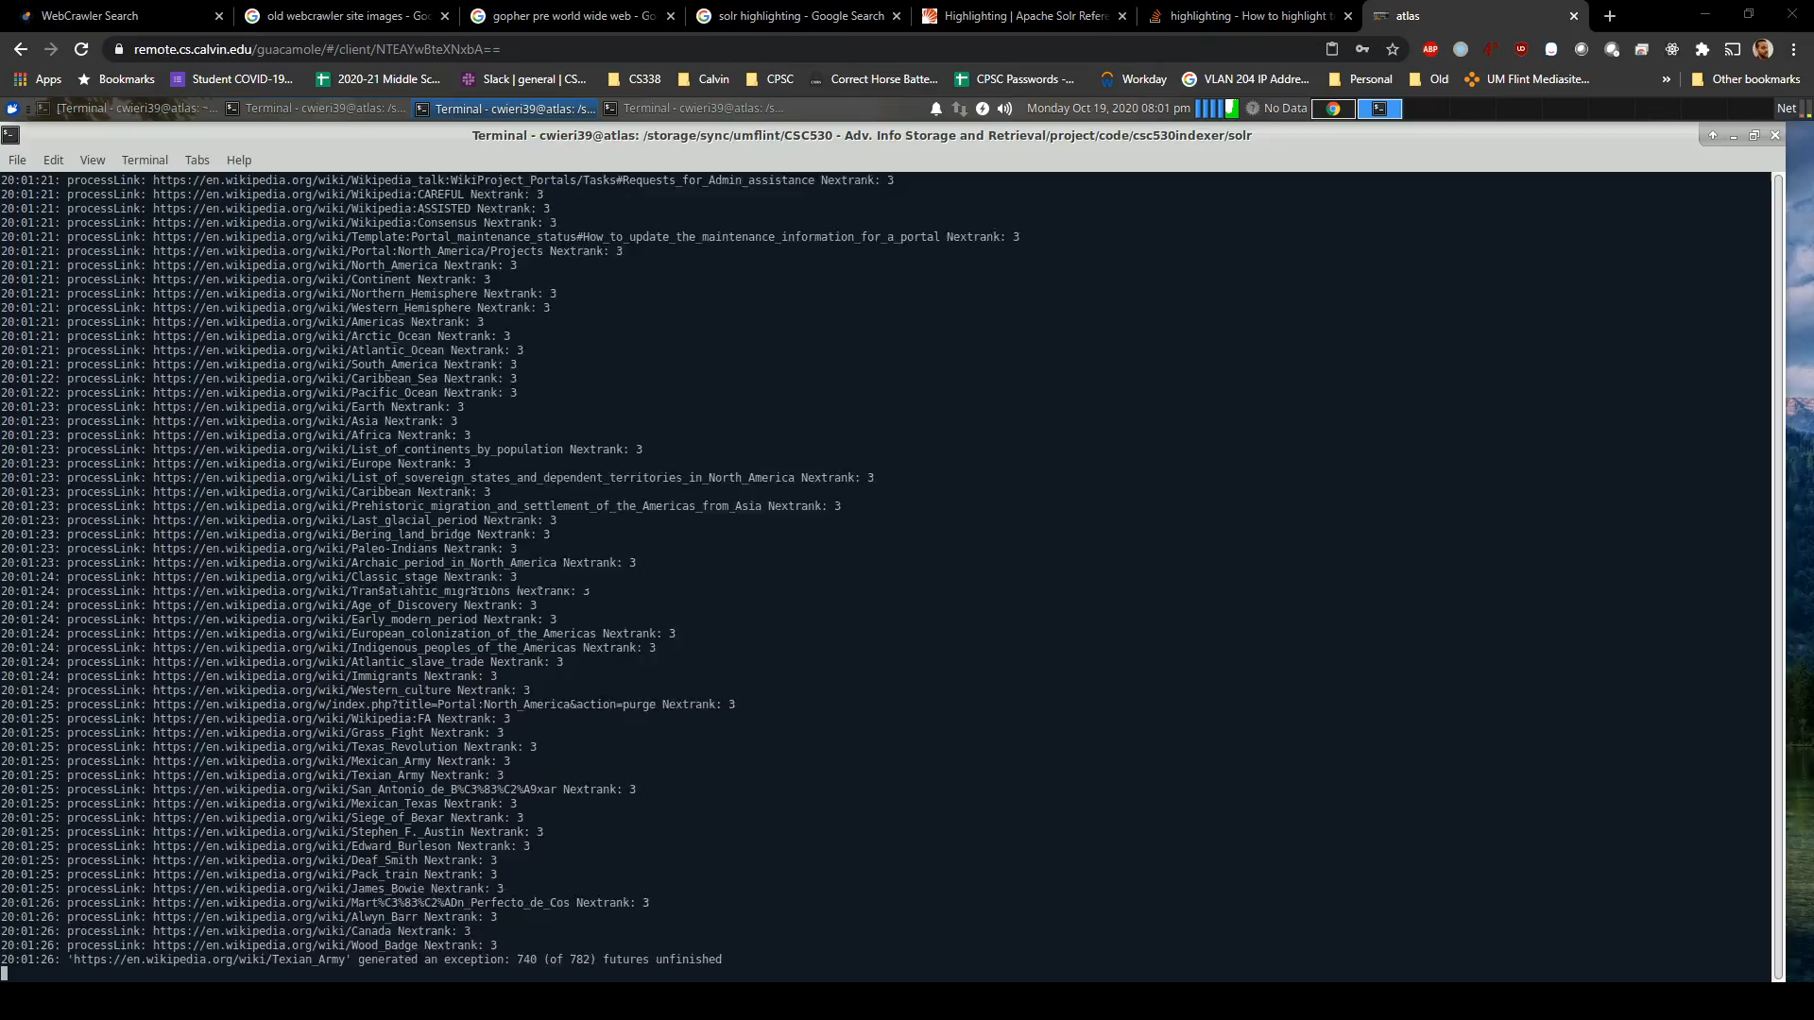
Web Crawler
Notes:
While this is pretty small and hard to see, here is my web crawler in action. The crawler is just a command line program that outputs each URL that it is working on. Right now, it is going through the rank 2 URLs and downloading each link that it encounters. All these downloaded pages are added to the database as rank 3 for future crawling.

Slide 11
Outline
Introduction
Web Crawler
Indexer
Search
Project Results
Future Work
References

Slide 12
Indexer
How does an indexer work?
Covered extensively in the CSC530 class
Page-centric data structure (documents words) to keyword-centric structure (words documents)
Apache Solr 11 – open-source indexer
Creates an inverted index
XML/HTTP/JSON APIs
Integrated search / query capabilities
Scalable solution
Notes:
Moving on to the Indexing piece. We have covered indexing quite extensively in this class so far, so here I’ll just give a brief reminder of how it works. An indexer typically is going to work from taking a collection of documents that contain words and making an index that allows you to query words to retrieve documents. For my project, I decided not to reinvent the wheel here, but to deploy Apache Solr which is “the popular, blazing-fast, open source enterprise search platform”. Solr will create an inverted index of your documents, has various APIs, integrated search and query capabilities, and can scale as big as your needs are.
https://lucene.apache.org/solr/

Slide 13
Indexer
Apache Solr 7.7.3 install on Ubuntu 18.04LTS
Attempted Solr in Kubernetes on Google Cloud and MicroK8s with partial success
Python scripts to populate Solr
Iterate through all downloaded pages / URLs
Upload the full-text HTML for processing via HTTP API using ‘curl’
curl <solrposturl>?literal.id=<weburl>&commit=true –F myfile=@<webpagefilepath>
Solr auto-index of HTML document types
Notes:
To implement Apache Solr I installed it on an Ubuntu 18.04 LTS workstation. I had several misstarts and couldn’t get the latest 8 series code working, but the most recent 7.7.3 series work flawlessly for me as a locally installed service. I additionally attempted to implement Solr in Kubernetes both on Google Cloud and locally using MIcroK8s but was only able to get it partially working, mainly having issues getting the web request routing to work correctly in Kubernetes, which I am not very familiar with. I did have to do a little bit of programming here. I wrote some Python scripts to populate Solr, where it iterated through all locally download pages and uploaded these full-text HTML files for processing to Solr through the HTTP API. I utilized the “curl” program to do this; you just needed to provide the appropriate SOLR URL to POST to along with a unique id and upload the file from the local file system. Solr automatically does HTML document parsing which saved a lot of time from me having to preprocess and prepare the text for indexing.

Slide 14
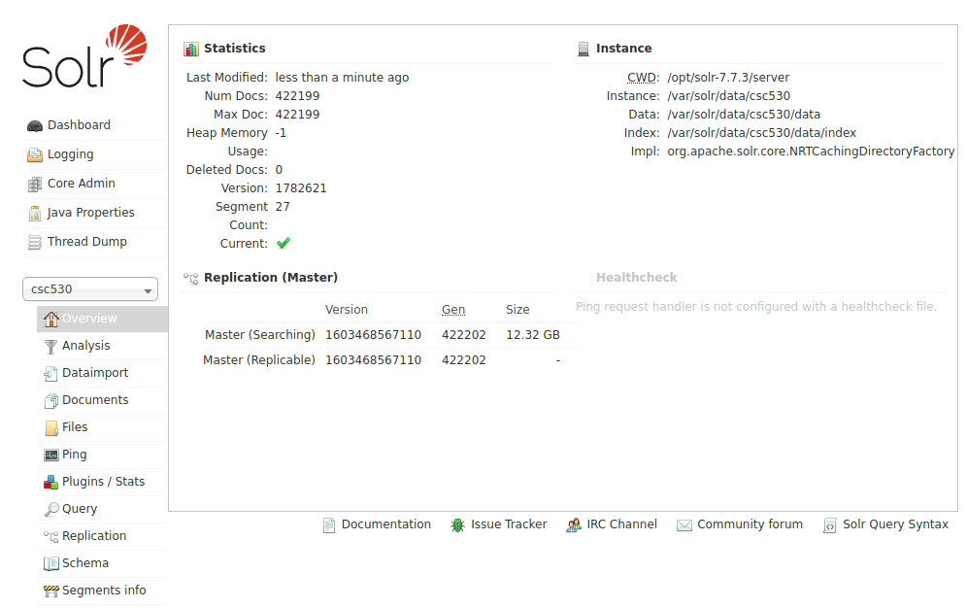
Indexer
Web interface to administer Solr:
Notes:
This is the Solr web interface – pretty simple, and has basic functionality for checking the status of the system, querying the catalog, which is your collection of documents, etc.

Slide 15
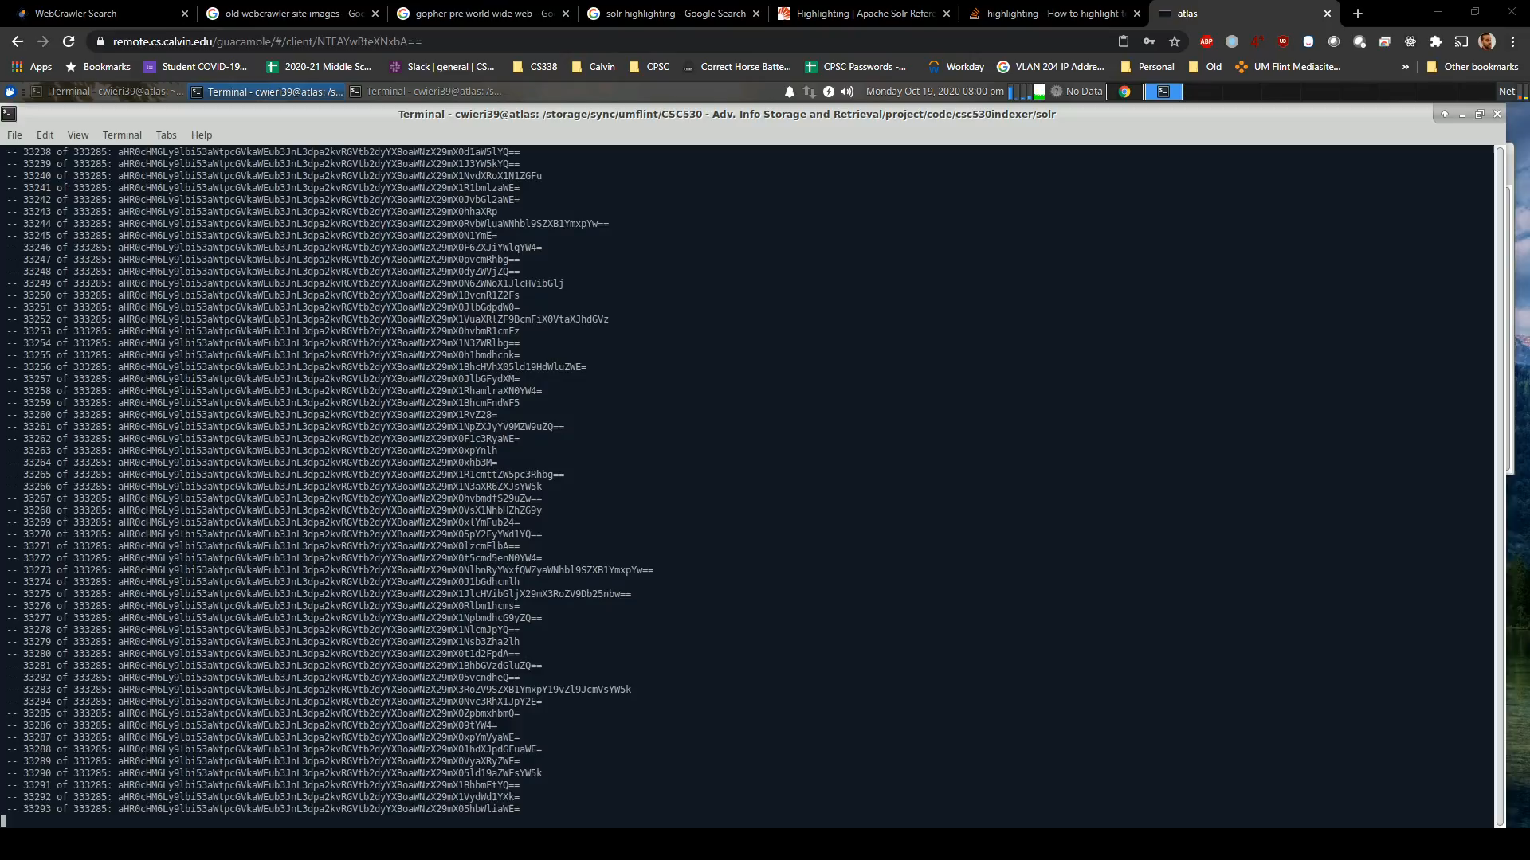
Indexer
Notes:
Here’s my Python index scripts in action – again, just a simple command line program that runs. Each web page that it processes takes about a half second to two or three seconds at the most.

Slide 16
Outline
Introduction
Web Crawler
Indexer
Search
Project Results
Future Work
References

Slide 17
Search
How does a Search interface work?
This is common knowledge by all
Supply a query term, get results back
Faster is better (to the user!)
Desire relevant results
Examples: Google, Bing, DuckDuckGo, etc
Notes:
And we come to the final part of the project, the search interface. Most everyone has a ton of experience with search engines, so I’m not going to spend a ton of time here. As the user, they are looking for fast and relevant results.

Slide 18
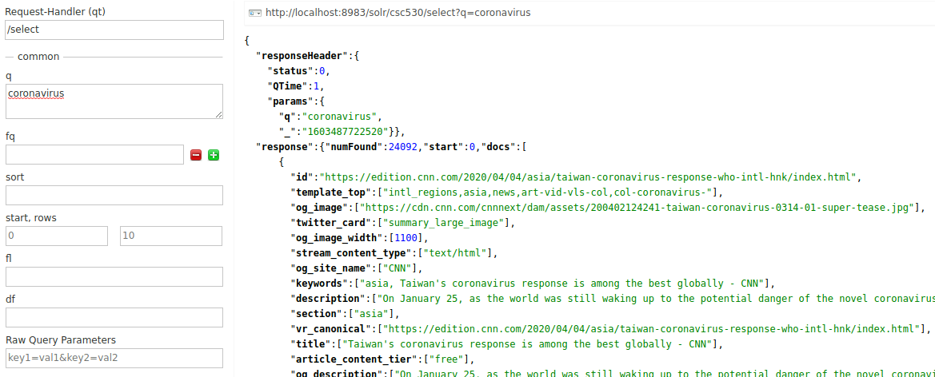
Search
Apache Solr provides a query interface, but the results are JSON…
Notes:
For my project, Apache Solr does provide a web interface for queries, but the interface is rather crude. Additionally, any results that come back are going to come back as JSON text, which is more machine-friendly than user-friendly. So I decided that this needed improvement on.

Slide 19
Search
React NodeJS12 frontend search webpage
Input for a query text, number of results, pagination
Simple response for results, showing URL title, link, score, cached HTML page, and picture (if applicable)
JavaScript asynchronous fetch using Solr Query API
JSON parsing native to JavaScript for displaying results through React
Available: https://atlas.cs.calvin.edu/csc530/
Notes:
So we come to the final part of the project, the programming a search interface. I started by modifying a previous master’s class final project of mine to interface with Solr. This uses React and NodeJS as the programming platform. The webpage interface uses a simple input for the search term, and allows the user to set the number of results along with pagination of results. Javascript allows for asynchronous fetch directly to the Solr Query API via HTTP. When the JSON results are returned from Solr, React builds the results from the query JSON dynamically and displays them to the user.

Slide 20
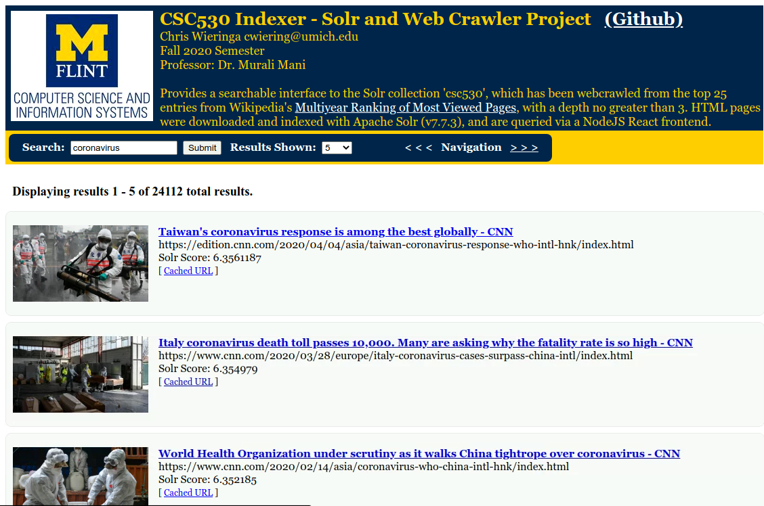
Search
Notes:
This is what the search interface looks like. This search is for “coronavirus” and returns a bunch of cnn.com pages.

Slide 21
Outline
Introduction
Web Crawler
Indexer
Search
Project Results
Future Work
References

Slide 22
Project Results
Resounding success overall!
Code available on Github
Crawling: started with top 25 most visited pages13 on Wikipedia from 2007-2020
Rank 1 count: 25 downloaded pages
Rank 2 count: 35,547 downloaded pages
Rank 3 count: 502,154+ downloaded pages
Defeat! Only fully crawled 2,255 pages total
87GB disk space used storing these pages
Wikipedia heavily links to themselves
Notes:
So how did my project do? Overall it was a great success. The crawling, indexing, and search interface all work together and I’ve created my own small search engine platform!
As for the crawling piece of the project, I started out with the top 25 most visited pages on Wikipedia – these were my initial rank 1 pages. Starting with those 25 pages, after the initial download and crawling of all linked pages I had an additional 35,547 pages to crawl; these became my rank 2 pages. I had to admit defeat after only crawling just over 2,000 of these rank 2 pages, as my total downloaded page count had grown to over a half a million downloaded pages. This was very bandwidth and disk space intensive; storing just the text pages on my disk took over 87 GB of space. Lastly, Wikipedia heavily links to themselves. Those first 25 pages average to have 1,422 links each, and the vast majority of those were self-referencial back to Wikipedia. So I downloaded a ton of Wikipedia pages. This makes me feel a bit guilty, so I’ve decided I’ll be sending them a sizable donation when this project is done.

Slide 23
Project Results
Indexing:
Total HTML files indexed: 518,371
Index size: 14.86GB
No issues with CPU or memory usage.
Crawling and Indexing Time: >1 week 24x7
Searching:
Deployed production build of ReactJS website as static HTML/JS/CSS files
Apache webserver ProxyPass for Solr query URL only (security risk to expose other API URLs)
https://atlas.cs.calvin.edu/csc530/
Notes:
Indexing, once I got it working, has worked flawlessly. Overall I’ve indexed over a half million documents and the index size is around 15GB. For a single-user system like for this project, I have not seen any scaling issues from CPU or memory usage.
However, dealing with a half million sites took time. Just the crawling and indexing of the sites I pulled down took around a week and a half of constant crawling, downloading and indexing in the background on my workstation.
As for searching, I deployed a production build of the ReactJS frontend website to the Apache webserver on the workstation where this is running. Apache also provides a ProxyPass to the Solr system running on localhost on the machine, only passing the query URL as it would be a security risk to expose the other APIs such as add, update, or delete.
And you can try the site by following the link given.

Slide 24
Outline
Introduction
Web Crawler
Indexer
Search
Project Results
Future Work
References

Slide 25
Future Work
Crawling:
Better deadlink detection
robots.txt refresh after elapsed time period
Horizontal Scaling
Cached page content refresh
Indexing:
Fixed-field indexing vs automatic field indexing
Full-text for summaries and term-highlighting
Horizontal Scaling
Searching:
More fields displayed
Additional filtering of results capabilities
Adult content-moderation
Mobile browser support
Notes:
Lastly for future work, there’s lot of places this project could be improved.
For crawling, I had a lot of deadlinks that paused my crawler. Better detection and timeouts of these dead links would make the crawler more efficient. I also implemented robots.txt support, but am only checking the robots.txt file once and caching it locally. This could be improved to refresh the robots.txt file after an elapsed period of time, such as an hour or day. This could also be scaled horizontally to more machines to help crawl more quickly. This also is not set up to refresh content after any amount of time, so figuring out how to recheck and refresh pages over time would be useful.
Indexing with Solr could also use some additional work. I allowed Solr to auto-index and field match using the built-in HTML parser. Better field management could be done if I did more text preprocessing with fixed fields. Adding full-text into Solr would allow for summary generation along with term-highlighting which doesn’t exist today.
For search, additional fields could be displayed in the results, especially if the field names were more standardized in Solr. Additional filtering options could be exposed as options as well to get more accurate results. Additionally, content moderation and filtering, for example for adult content, could be added. Lastly, mobile browser support could be added.

Slide 26
Outline
Introduction
Web Crawler
Indexer
Search
Project Results
Future Work
References

Slide 27
References
1. https://en.wikipedia.org/wiki/Gopher_(protocol)
2. https://en.wikipedia.org/wiki/Timeline_of_web_search_engines
3. https://en.wikipedia.org/wiki/Netscape_Navigator
4. https://logodix.com/logo/749520.jpg
5. https://www.researchgate.net/figure/Web-Crawler-Free-Icon-Available-from-Online-Web-Fonts_fig4_338226442
6. https://www.hiclipart.com/search?clipart=Solr
7. https://commons.wikimedia.org/wiki/File:System_search_icon.png
8. https://www.crummy.com/software/BeautifulSoup/bs4/doc/
9. https://dataset.readthedocs.io/en/latest/
10. https://docs.python.org/3/library/urllib.robotparser.html
11. https://lucene.apache.org/solr/
12. https://reactjs.org/
13. https://en.wikipedia.org/wiki/Wikipedia:Multiyear_ranking_of_most_viewed_pages
Notes:
Here’s the references for this presentation.

Slide 28
Thank you!
Thanks for listening! Try the search site yourself at:
https://atlas.cs.calvin.edu/csc530/ or get the GitHub code at:
https://github.com/chriswier/csc530indexer

Slide 29
Search
Demo!
Notes:
This is what the search interface looks like. This search is for “coronavirus” and returns a bunch of cnn.com pages.

